Slide 1
Final Project
Benjamin Pixton

Slide 2
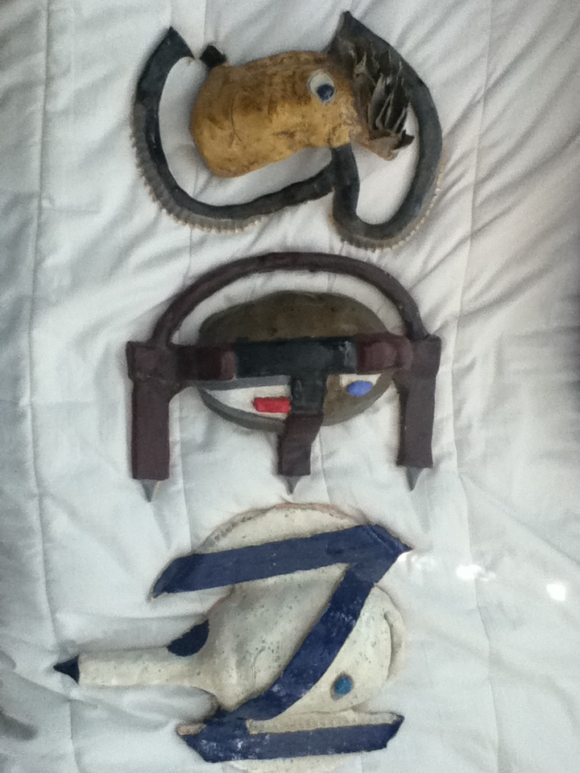
Me, Myself, and I

Slide 3
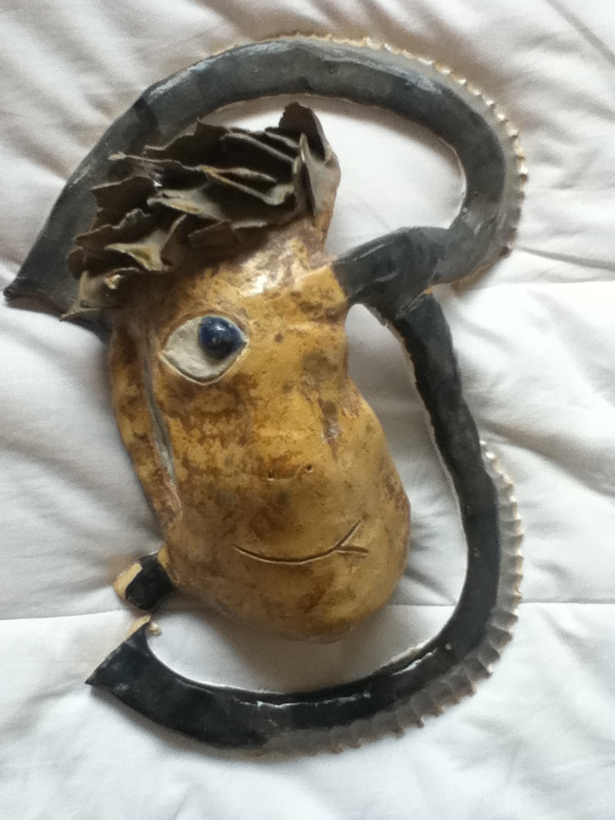
Letter “B”
The first letter of my name stands for “Brave” (not very humble I know).
The face is made to look like wood whereas the hair is made of leaves.
The B itself is made to look like a blade.
The mouth has a smile but on one side it also is going down into a frown indicating that I prefer to be happy in place of sad.

Slide 4
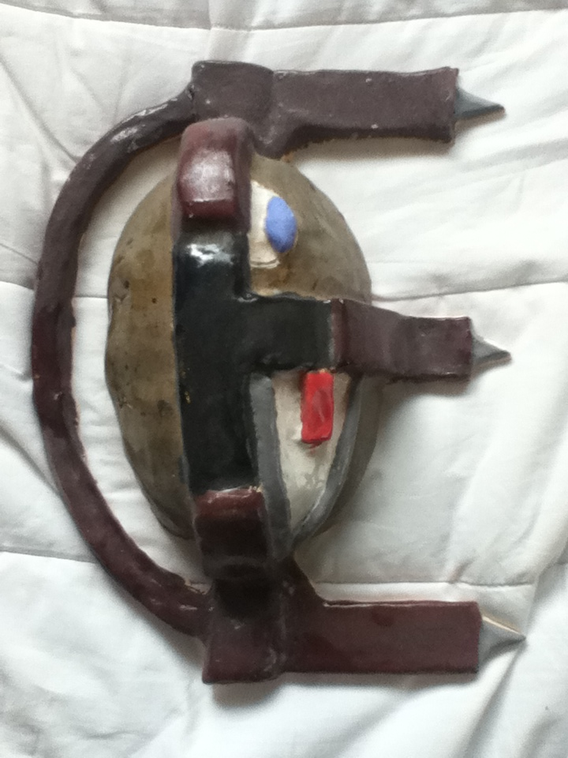
Letter “E”
The letter E in my name stands for “Energy”
One eye is normal whereas the other is robotic symbolizing the need for balance between spiritual (blue eye) and physical (red eye) energy.

Slide 5
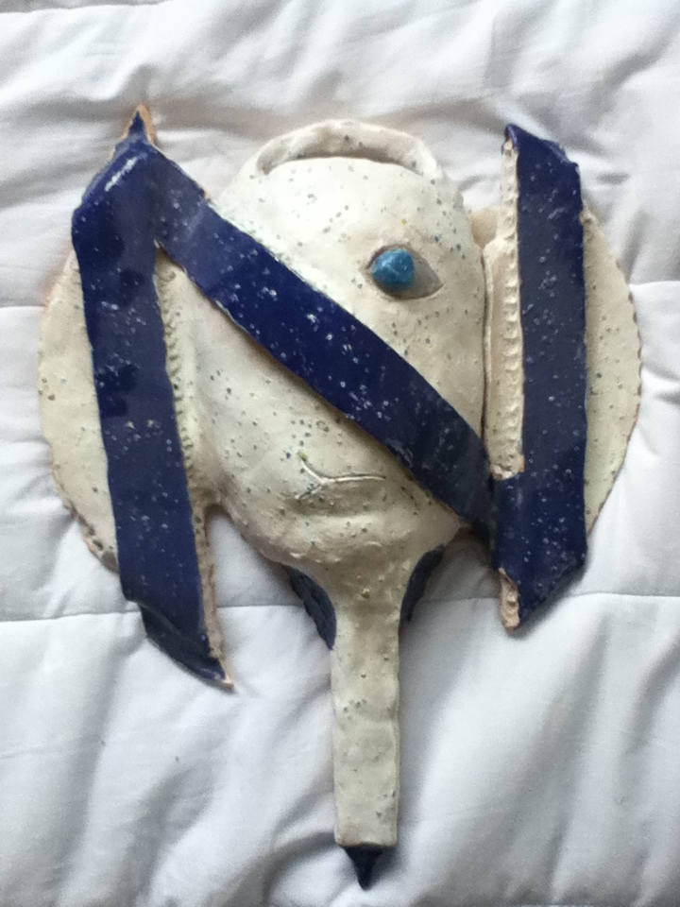
Letter “N"
The letter N in my name Stands for “Nature.”
The spreckles are for the stars in space symbolizing my love for nature.
This mask was made into an axe to symbolize the danger of nature and the necessity to be prepared.

Slide 6
Summary
These masks were made to symbolize myself. Each one symbolizes something by itself however at the same time together they come together to make something even bigger.
They are not perfect if you look closely two of the three letters broke. One broke while inside the Kiln (heat and pressure) and the other from human error (Imperfection). These can convey the fact that I don’t see myself as being perfect. I have had many trials in life and at times I have “broken” but I am who I am because of those trials and while I may never be able to correct all of my past mistakes and imperfections I can still try.

